Slide 1

TASK 1
Web scraping to gain company insights

Slide 2
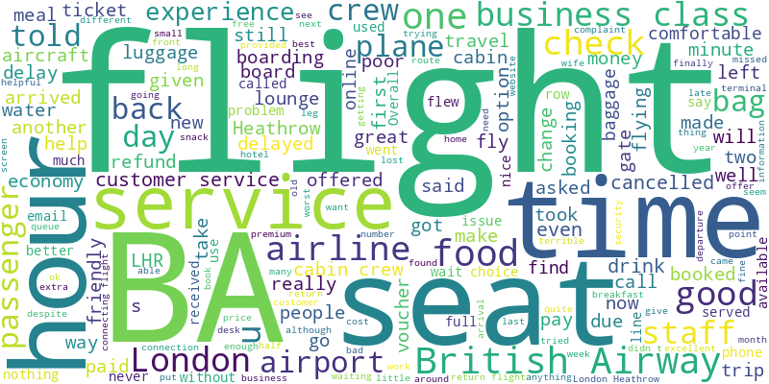
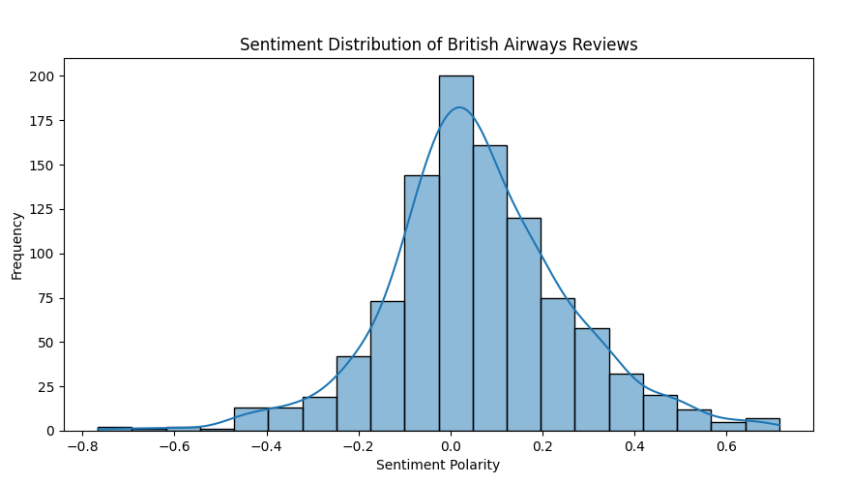
Word Cloud
Sentiment Distribution Histogram
Out of 1000 reviews, 541 were positive, 439 were negative and
20 were neutral. This means the majority of reviews were
polarised as either positive or negative
The graph visualizes the sentiment distribution of British Airways reviews, showing a range of sentiment polarities with a normal distribution centered around neutral sentiment (0).

